Slide 1
Labour reallocation, informality and productivity growth in BRICs*
Ilya B. Voskoboynikov,
National Research University Higher School of Economics and GGDC
Prepared for the joint seminar of the Laboratory for Labour Market Studies and the Centre for Labour Market Studies, December 24, 2013
*Updated version of G. de Vries, A.A. Erumban, M.P.Timmer, I.Voskoboynikov, H.X. Wu, 2012, Deconstructing the BRICs: Structural Transformation and Economic Growth”

Slide 2
Development entails structural change…
Structural change, narrowly defined as the reallocation of labor across sectors, featured prominently in the early analysis of economic growth (e.g. by Kuznets, 1966)
The best documented pattern of structural change is the shift of labor and capital from production of primary goods to manufacturing and services
Growth rate of productivity is different across sectors, reflecting differences in the nature of the production function, in investment opportunities and in the rate of technical change (Syrquin 1984; Crafts 1984)
These differences in the potential for structural change featured prominently in explanations of differential growth within European countries in the post-WW-II period (Dennison 1967; Maddison 1987; Timmer et al. 2010)
However, little is known about the development pattern that underlies aggregate progress in the BRIC countries

Slide 3
THE BRICs around the world

Slide 4
This paper (novelty)
A harmonized time-series database of value added and persons engaged by sector with a common industry classification
Based on a critical assessment of the reliability, consistency, as well as the concepts and definitions used in various primary data sources
For Brazil, India and Russia we are able to split sectoral GDP and employment into formal and informal sectors
Disclaimer: definitions of the informal sector differ between Brazil and India, and the data quality regarding informal sector development patterns is subject to larger uncertainty

Slide 5
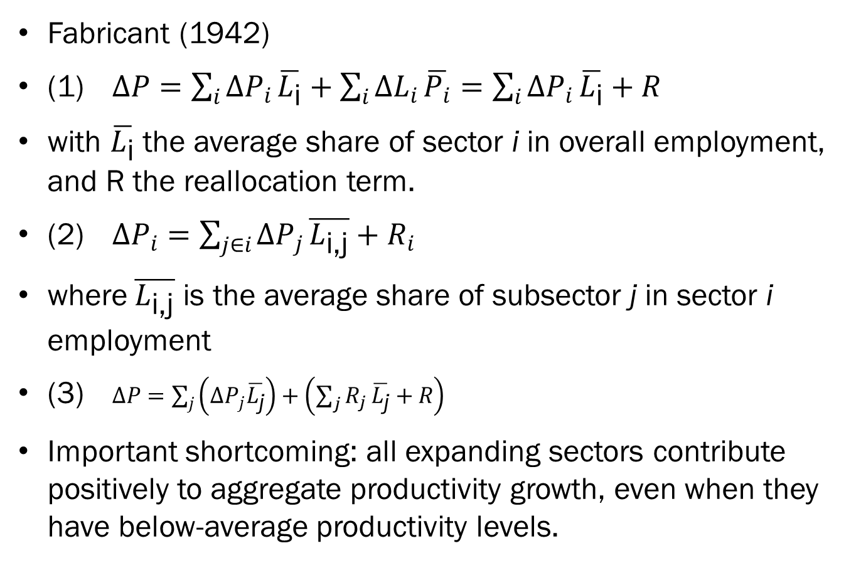
approach
Fabricant (1942)
(1) $∆P=\sum_{i}{∆P_{i}}\overline{L_{\text{i}}}+\sum_{i}{∆L_{i}}\overline{P_{i}}=\sum_{i}{∆P_{i}}\overline{L_{\text{i}}}+R$
with $\overline{L_{\text{i}}}$ the average share of sector i in overall employment, and R the reallocation term.
(2) $∆P_{i}=\sum_{j∈i}{∆P_{j}}\overline{L_{\text{i}\text{,}\text{j}}}+R_{i}$
where$\overline{L_{\text{i}\text{,}\text{j}}}$ is the average share of subsector j in sector i employment
(3) $∆P=\sum_{j}{\left(∆P_{j}\overline{L_{\text{j}}}\right)}+\left(\sum_{j}{R_{j}}\overline{L_{\text{j}}}+R\right)$
Important shortcoming: all expanding sectors contribute positively to aggregate productivity growth, even when they have below-average productivity levels.

Slide 6
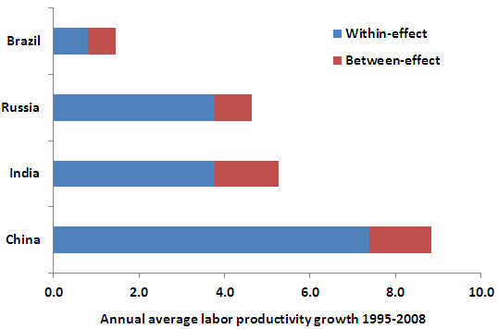
Aggregate decomposition results, 1995-2008

Slide 7
Structural change and agr. productivity growth: brazil
 | 1995- 2008 | 1995-2008 |  | 1980- 1995 | 1980-1995
 | 3-sector | 35-sector |  | 3-sector | 35-sector
Contribution of productivity growth in:
Agriculture | 0.3 | 0.3 |  | 0.2 | 0.2
Industry | 0.2 | 0.2 |  | -0.2 | -0.2
Services | 0.1 | 0.5 |  | -2.0 | -1.6
All sectors (1) | 0.6 | 1.0 |  | -2.0 | -1.6
Reallocation (2) | 0.6 | 0.1 |  | 1.1 | 0.8
Aggregate productivity growth (3) = (1) +(2) | 1.1 | 1.1 |  | -0.9 | -0.9

Slide 8
Structural change and agGr. productivity growth: RUSSIA
 | 1995-2008 | 1995-2008
 | 4-sector | 35-sector
Contribution of productivity growth in:
Agriculture | 0.2 | 0.2
Mining &Wholesale trade | 0.4 | 0.3
Industry | 1.3 | 1.2
Services | 1.9 | 1.8
All sectors (1) | 3.8 | 3.5
Reallocation (2) | 0.8 | 1.1
Aggregate productivity growth (3) = (1) +(2) | 4.5 | 4.5

Slide 9
Structural change and agGr. productivity growth: INDIA
 | 1991- 2008 | 1991-2008 |  | 1981- 1991 | 1981-1991
 | 3-sector | 31-sector |  | 3-sector | 31-sector
Contribution of productivity growth in:
Agriculture | 0.5 | 0.5 |  | 0.5 | 0.5
Industry | 0.9 | 1.0 |  | 0.5 | 0.2
Services | 2.5 | 1.9 |  | 1.1 | 0.8
All sectors (1) | 3.8 | 3.4 |  | 2.1 | 1.5
Reallocation (2) | 0.9 | 1.3 |  | 0.9 | 1.4
Aggregate productivity growth (3) = (1) +(2) | 4.7 | 4.7 |  | 3.0 | 3.0

Slide 10
Structural change and agGr. productivity growth: CHINA
 | 1997- 2008 | 1997-2008 |  | 1987- 1997 | 1987-1997
 | 3-sector | 35-sector |  | 3-sector | 35-sector
Contribution of productivity growth in:
Agriculture | 0.6 | 0.6 |  | 0.9 | 0.9
Industry | 4.4 | 4.6 |  | 4.6 | 4.5
Services | 2.5 | 2.6 |  | 1.2 | 1.5
All sectors (1) | 7.5 | 7.9 |  | 6.7 | 6.8
Reallocation (2) | 1.2 | 0.8 |  | 1.0 | 0.9
Aggregate productivity growth (3) = (1) +(2) | 8.7 | 8.7 |  | 7.7 | 7.7

Slide 11
Informal sectors – data and definitions
Definitions of the informal sector vary:
India: based on an employment size threshold, where the organized sector consists of firms employing 10 or more workers using power, and 20 or more workers without using power
Information on NDP from national account statistics, employment from NSSO surveys
Brazil: informal employment defined according to contract status. Also, autonomous workers, comprising own-account workers and employers of unregistered firms are considered part of the informal sector.
Information on employment from national account statistics, GDP estimates based on value added per worker ratios from PNAD for wages of informal employees and ECINF for profits of autonomous workers
Russia: labels a worker as informal if he/she is employed in a non-corporate enterprise. Informal employment is the difference between total employment (BLC) and organizations (Full Circle). Value added: based on official data on corrections of sectoral VA on informal activities and non-market households production.

Slide 12
Russia: empl. Shares and relative productivity levels
 | 2003 | 2008 | 2003 | 2008
 | L_{i} | L_{i} | RPIF_{i} | RPIF_{i}
Agriculture | 71 | 72 | 0.53 | 0.39
Manufacturing | 14 | 16 | 0.14 | 0.11
Construction | 39 | 40 | 0.13 | 0.15
Trade, excl. Wholesale Trade | 71 | 67 | 0.74 | 0.52
Hotels and restaurants | 27 | 38 | 0.38 | 0.63
Transport and communication services | 19 | 24 | 0.20 | 0.16
Business services | 10 | 14 | 1.02 | 1.42
Education | 3 | 4 | 0.98 | 0.71
Health and Social work | 3 | 4 | 1.37 | 0.60
Other services | 28 | 30 | 0.11 | 0.12
All sectors* | 33 | 34 | 0.26 | 0.25
Note: IL_{i} refers to the employment share of informal activities in sector I (per cent). RPIF_{i} refers to the productivity level of informal activities relative to the formal activities within sector i.

Slide 13
russia: Informal activities and aggregate productivity growth
 | 2003-2008 | 2003-2008
 | 14-sector | informal split
Contribution of productivity growth in:
Agriculture | 0.18 | 0.19
Industry | 1.40 | 1.49
Services | 2.80 | 2.88
Mining and Wholesale trade | 0.75 | 0.75
All sectors (1) | 5.13 | 5.32
Reallocation (2) | 0.92 | 0.73
Aggregate productivity growth (3) = (1) +(2) | 6.05 | 6.05
Note: Aggregate productivity growth is the average annual logarithmic growth rate. Numbers may not sum due to rounding.

Slide 14
Brazil: empl. Shares and relative productivity levels
 | 2000 | 2008 | 2000 | 2008
 | IL_{i} | IL_{i} | RPIF_{i} | RPIF_{i}
Agriculture | 90 | 86 | 0.09 | 0.11
Mining | 51 | 34 | 0.32 | 0.18
Manufacturing | 48 | 40 | 0.33 | 0.27
Public utilities | 29 | 18 | 0.58 | 0.39
Construction | 82 | 74 | 0.14 | 0.16
Trade, hotels, and restaurants | 58 | 49 | 0.29 | 0.26
Transport services | 58 | 52 | 0.28 | 0.26
Communication services | 68 | 66 | 0.22 | 0.22
Financial and business services | 23 | 20 | 0.40 | 0.34
Other services | 63 | 59 | 0.27 | 0.26
All sectors | 62 | 55 | 0.27 | 0.25
Note: IL_{i} refers to the employment share of informal activities in sector I (per cent). RPIF_{i} refers to the productivity level of informal activities relative to the formal activities within sector i.

Slide 15
Brazil: Informal activities and aggregate productivity growth
 | 2000-2008 | 2000-2008
 | 10-sector | informal split
Contribution of productivity growth in:
Agriculture | 0.33 | 0.19
Industry | -0.10 | -0.50
Services | 0.59 | 0.07
All sectors (1) | 0.83 | -0.24
Reallocation (2) | 0.17 | 1.24
Aggregate productivity growth (3) = (1) +(2) | 1.00 | 1.00
Note: Aggregate productivity growth is the average annual logarithmic growth rate. Numbers may not sum due to rounding.

Slide 16
india: empl. Shares and relative productivity levels
 | 1993 | 2004 | 1993 | 2004
 | L_{i} | L_{i} | RPIF_{i} | RPIF_{i}
Agriculture | 99 | 99 | 0.06 | 0.05
Mining | 57 | 58 | 0.06 | 0.07
15t16 | 83 | 88 | 0.14 | 0.10
17t19 | 87 | 92 | 0.12 | 0.09
20 | 98 | 99 | 0.32 | 0.10
21t22 | 72 | 88 | 0.15 | 0.09
23 | 58 | 49 | 0.01 | 0.01
24 | 64 | 73 | 0.05 | 0.03
25 | 70 | 73 | 0.28 | 0.47
26 | 88 | 92 | 0.09 | 0.06
27t28 | 71 | 83 | 0.13 | 0.05
29 | 73 | 77 | 0.26 | 0.20
30t33 | 54 | 74 | 0.37 | 0.15
34t35 | 22 | 72 | 0.43 | 0.05
36t37 | 98 | 97 | 0.03 | 0.03
Public utilities | 29 | 36 | 0.08 | 0.09
Construction | 90 | 96 | 0.12 | 0.07
Trade, hotels, and restaurants | 99 | 99 | 0.16 | 0.05
Transport and communication services | 69 | 83 | 0.33 | 0.32
Financial and business services | 55 | 74 | 1.22 | 0.28
Other services | 64 | 72 | 0.21 | 0.15
All sectors | 92 | 94 | 0.12 | 0.08

Slide 17
india: Informal activities and aggregate productivity growth
 | 1993-2004 | 1993-2004
 | 21-sector | informal split
Contribution of productivity growth in:
Agriculture | 0.3 | 0.3
Industry | 0.8 | 1.4
Services | 1.6 | 2.1
All sectors (1) | 2.7 | 3.8
Reallocation (2) | 1.1 | 0.0
Aggregate productivity growth (3) = (1) +(2) | 3.8 | 3.8
Note: Aggregate productivity growth is the average annual logarithmic growth rate. Numbers may not sum due to rounding.

Slide 18
conclusion
This paper studied patterns of structural change and productivity growth in four major developing countries since the 1980s, the BRIC countries, using a newly constructed detailed sector database.
Based on a structural decomposition, we find that for China, India and Russia reallocation of labour across sectors is contributing to aggregate productivity growth, whereas in Brazil it is not.
However, this result is overturned when a distinction is made between formal and informal activities within sectors. Increasing formalization of the Brazilian economy since 2000 appears to be growth-enhancing, while in India and, to a lesser extent in Russia the increase in informality is growth-reducing.
The level of disaggregation is essential for the analysis of reallocation.

